Slide 1
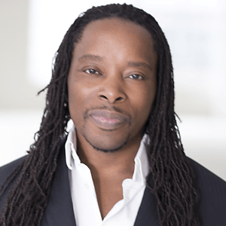
Leading Social Justice in Your School
Session 2: Who Am I and Why Am I Here?
Designed and Lead by
Dr. Omekongo Dibinga

Slide 2
Who am I?
I am the Latino teenager who works part-time in your mailroom.
You know
The one you think is in a gang, just because I use street slang.
Who a m I ?
I'm the Black woman who works in your group.
You k n o w
The one who wears her hair in braids, or a natural, or dreadlocks,
the one you call a radical with an attitude.
Who am I?
I am your blind neighbor.
Y o u k n o w
The one you always speak loudly to, as though I had a hearing disability,
Instead of one of sightlessness.
Who am I?
I'm the Korean grocer in your neighborhood
You know
The one you call unfriendly, just because I don't smile enough for you.
Who am I?
I am a lesbian, or the gay person who is your associate.
You know . . . oops, maybe you don't know.
I chose not to share that aspect of
Who I am ,
Because you and your friends are always joking about "Homo's",
And "queers", and "lesbos".
If you only knew how closely I work with you.
Who am I?
I am the Japanese American who works in your sales department.
You know
The one whose name you make fun of and expect me to laugh.
Who am I?
I am the Christian woman who travels with you to make client calls.
You know
The one you keep apologizing to, every time you tell an off-color joke,
Or use God's name in vain.
Why do you apologize?
You obviously are not sorry, or you would change your behavior.
Who am I?
I am the older man.
You know
The one you get impatient with
Because I don't talk, move, or drive as fast as you do.
One day you will be old,

Slide 3
Unless you experience the only other alternative.
Who am I?
I am your administrative assistant.
You know
The one you always call "Hon" or "Sweetie” whenever you want coffee.
How many years will it take for you to learn my real name?
Who am I?
I am the new associate who just relocated to your office.
You know
The one you imitate all the time, because of my southern accent.
Who am I?
I am the American Indian.
You know
The one you call chief, and ask how's my squaw.
If you were interested in me as an individual,
You would know that squaw is a derogatory French Canadian term, and chief is not a word I joke about.
Who am I?
I am the Puerto Rican.
You know
The one who speaks Spanish to my friends at work.
You think we are talking about you . . .don't flatter yourself.
Who am I?
I 'm the African American man who works down the hall.
You know
The one you and your friends say, I only got my job because of my color,
Of course not because I was the best candidate.
Who am I?
I am the Chinese American human resource specialist.
You know
The one you keep asking to help you with your computer,
Even though I don't understand that technical stuff either.
Who am I?
I am a White American.
You know
The one you blame for the errors made over 200 years ago,
The one you think "has it made",
The one you think "just doesn't get it",
Even though I am your strongest advocate among my peers.
Who am I?
I am an American person
I worry about the environment ,
Education for my children, my next paycheck,
Crime, and crabgrass in my front yard.
I am the person who wants to know
The real you,
If only you would act interested in the real me.
Dr. Lenora Billings –Harris, 1994

Slide 4
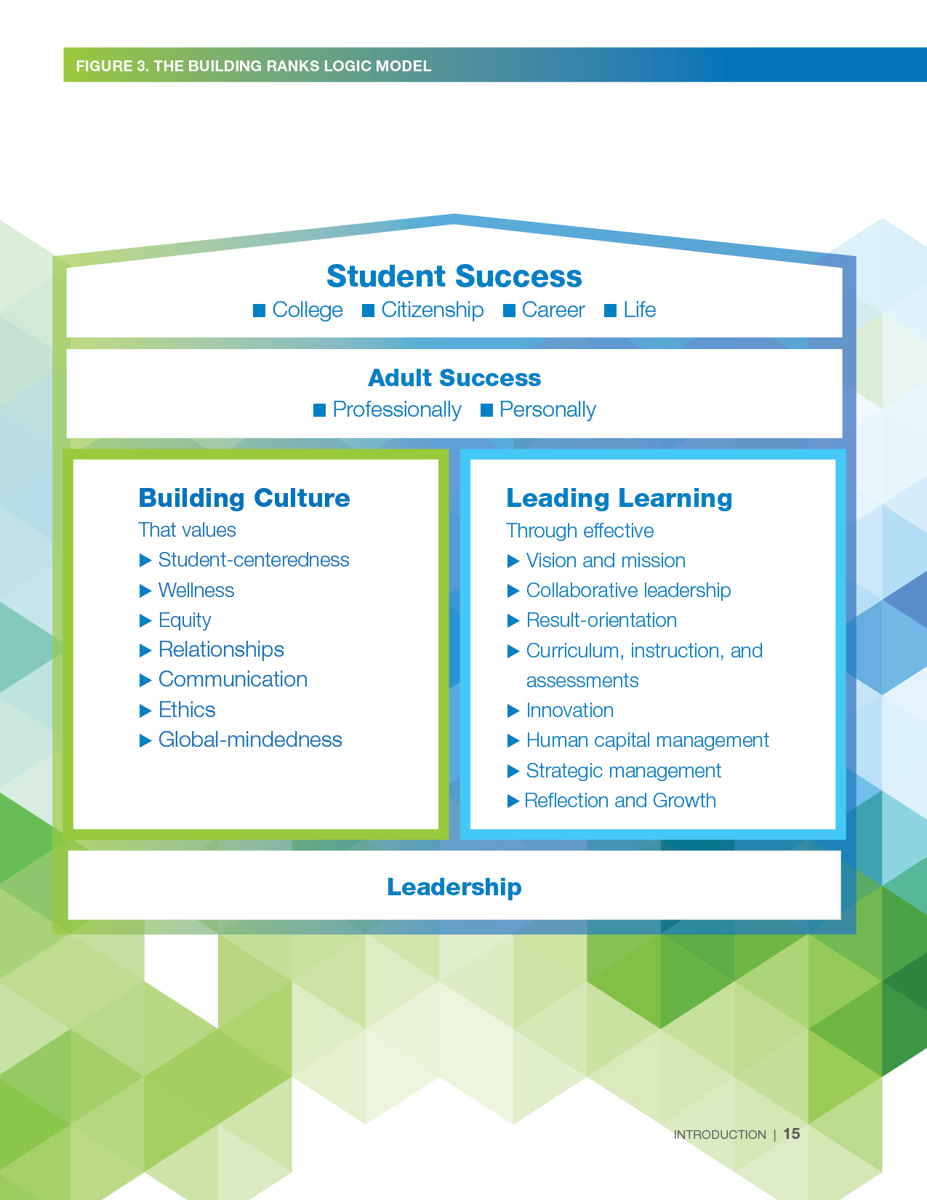
grounded in Building ranks’ equity
Notes:
NASSP developed Building Ranks to create a common language that describes the critical and complex role of the school leader. This session highlights equity – one dimension of the Building Ranks framework. And specifically, one aspect of equity, social justice. NASSP is committed to social justice and supporting your leadership. Thank you for committing to your own social justice leadership.

Slide 5
Ground Rules
Be willing to surface and explore unconscious beliefs and values.
Listen to hear, not respond.
Be willing to think about situations with a new or expanded perspective.
Be mindful that your truth can be different for others.
Honor confidentiality.
Take responsibility for your own learning.

Slide 6
Social Justice Defined
The view that everyone deserves equal economic, political and social rights and opportunities.
(The San Diego Foundation)

Slide 7
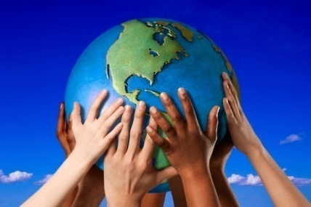
Enduring Understanding:
Social justice is a cornerstone of our school community.

Slide 8
Enduring Understanding:
Social justice is a cornerstone of our school community.
Essential Questions:
1. How do awareness, knowledge, and understanding of my own identity and history affect my commitment to equity and social justice?
2. How do awareness, knowledge, and understanding of the identity and experiences of my students, faculty, and staff affect my commitment to equity and social justice?
3. How can school leaders establish environments that are conscious of culture to ensure implementation of equity and social justice?
Notes:
The essential question and enduring understanding for equity professional development

Slide 10
Assignments for today
Part 1
Reflect on your stage of identity development and assess whether you can also be part of the opposite group. For example, think of the following questions:
What was I taught about my identity growing up from my family that most affected my growth positively or negatively?
What messages did I receive about who I was when I left my home every day (in school, from friends, my teachers, etc.)?
How did my schooling reinforce a positive or negative identity development for me?
What experiences in my life influenced the social justice causes I believe in?
What was I taught about the identity of others and how did that affect my identity development?
Did my upbringing create stereotypes and biases towards others that I’ve had to work to change (or still need to)? Please elaborate on your answer.
What about my past identity experiences led me to become an educator and eventually a teacher or school leader?

Slide 11
Community Share Out
On a volunteer basis, we will spend the next few minutes hearing what the exercise on ethnic and racial identity development was like for some of you.

Slide 12
SURFACE CULTURE
(Explicit Culture)
DEEP CULTURE
(Implicit Culture)

Slide 13
fine arts drama
literature music
SURFACE CULTURE
(Explicit Culture)
VISIBLE
folk dancing cooking
dress games
Notions of modesty Conception of beauty Rules of descent
Ideals governing child raising Cosmology Relationship to animals
Definition of sin Patterns of superior/subordinate relationship
Courtship practices Conception of justice Incentives to work
Notions of leadership Tempo of work Patterns of group decision- making
Conception of cleanliness attitudes toward the dependent Theory of disease
Approaches to problem-solving Conception of status Mobility
Eye behavior
Roles in relationship to status by age, sex, class, occupation, kinship, etc.
Conversational patterns in various social contexts conception of past and future
Definition of insanity Nature of friendship Ordering of time body language
Facial expressions Conception of “self” patterns of visual perception
Preference for competition or Cooperation Social interaction rate
Notions of adolescence Notions about logic and validity
Patterns of handling emotions
Arrangement of physical space...AND MUCH, MUCH MORE...
DEEP CULTURE
(Implicit Culture)
INVISIBLE

Slide 14
source: Montgomery County Public Schools

Slide 15
The dangers of a
single story

Slide 16
Activity
What single story have you had about a particular group?
How did you learn that story?
Has that story changed?
If so, how?
If not, why?
https://www.ted.com/talks/chimamanda_ngozi_adichie_the_danger_of_a_single_story#t-648925

Slide 17
You could be passing single stories on to your
students, faculty, parents, and staff.

Slide 18
The Rule of 7
The goal of this exercise to test what kind of world you actually live in as it relates to diversity, equity, and inclusion (DEI). Part of being truly committed to social justice is ensuring that you occupy spaces where you are a true partner to the causes that are important to your community and most importantly for this session, your school community. This exercise is also important as we do our work in going from allies to partners as we build on that corner stone we call social justice.

Slide 19
The Rule of 7
What do your 7 closest friends look like?
Who are the authors of the last 7 books that you read?
What do your 7 closest neighbors (in terms of proximity) look like?
What does the cast of the last 7 shows and movies you’ve watched look like?
What do the 7 closest members of your work team look like?
What do your top 7 personal service providers look like (doctors, dentists, etc.)?
What do the 7 leaders of your congregation look like?

Slide 20
Activity
Discuss The Rule of 7 in your groups.

Slide 21
The Rule of 7
You can add your own questions to “The Rule of 7” activity. The most important point is that you actually ask yourself questions that will challenge how you live a 24/7 life that revolves around your daily world.
This exercise can also be conducted with the children in your personal lives, your students & their parents, and your colleagues at your school.
There are also two questions to ask after you complete this exercise: 1) why are your responses what they are and 2) how did this occur?
The how question may require you to delve deeply into the history of social injustice in America.

Slide 22
Assignments for today
Part 2
In our next session, we will start to look more deeply at what social justice initiatives in your school look like. Come to our next session ready to share publicly or in your breakout rooms what your social justice initiatives look like. If you have embarked on no social justice initiatives in your school, share that as well. You are also invited to think about challenges you may have with embarking on social justice initiatives in your school. Some prompts to consider:
How does my school define social justice, if we have at all?
Does the school have a uniform opinion on what social justice is?
What does a social justice emphasis look like in my school (curriculum, hiring, student engagement, etc.?
Are there social justice initiatives that I would like to embark but I am afraid to (ex. starting a #blacklivesmatter or #stopaisanhate campaign).
Are there social jus

Slide 23
Hearing this information makes me think…
What are the implications for me in my role?
Reflections on my role.
Challenges I face with respect to social justice & equity in schools are…
Therefore, I will…
By participating in this session, I’ve changed my thinking about…

Slide 24
Leading Social Justice in Your School
Session 2: Who Am I and Why Am I Here?
Designed and Lead by
Dr. Omekongo Dibinga

