Slide 1
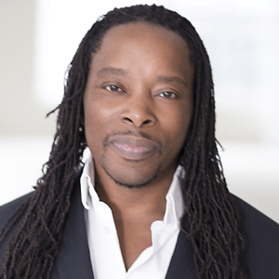

Leading Social Justice in Your School
Session 1: Who Am I and Why Am I Here?
Designed and Lead by
Dr. Omekongo Dibinga

Slide 2

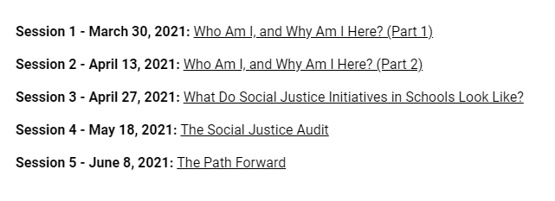

Slide 3
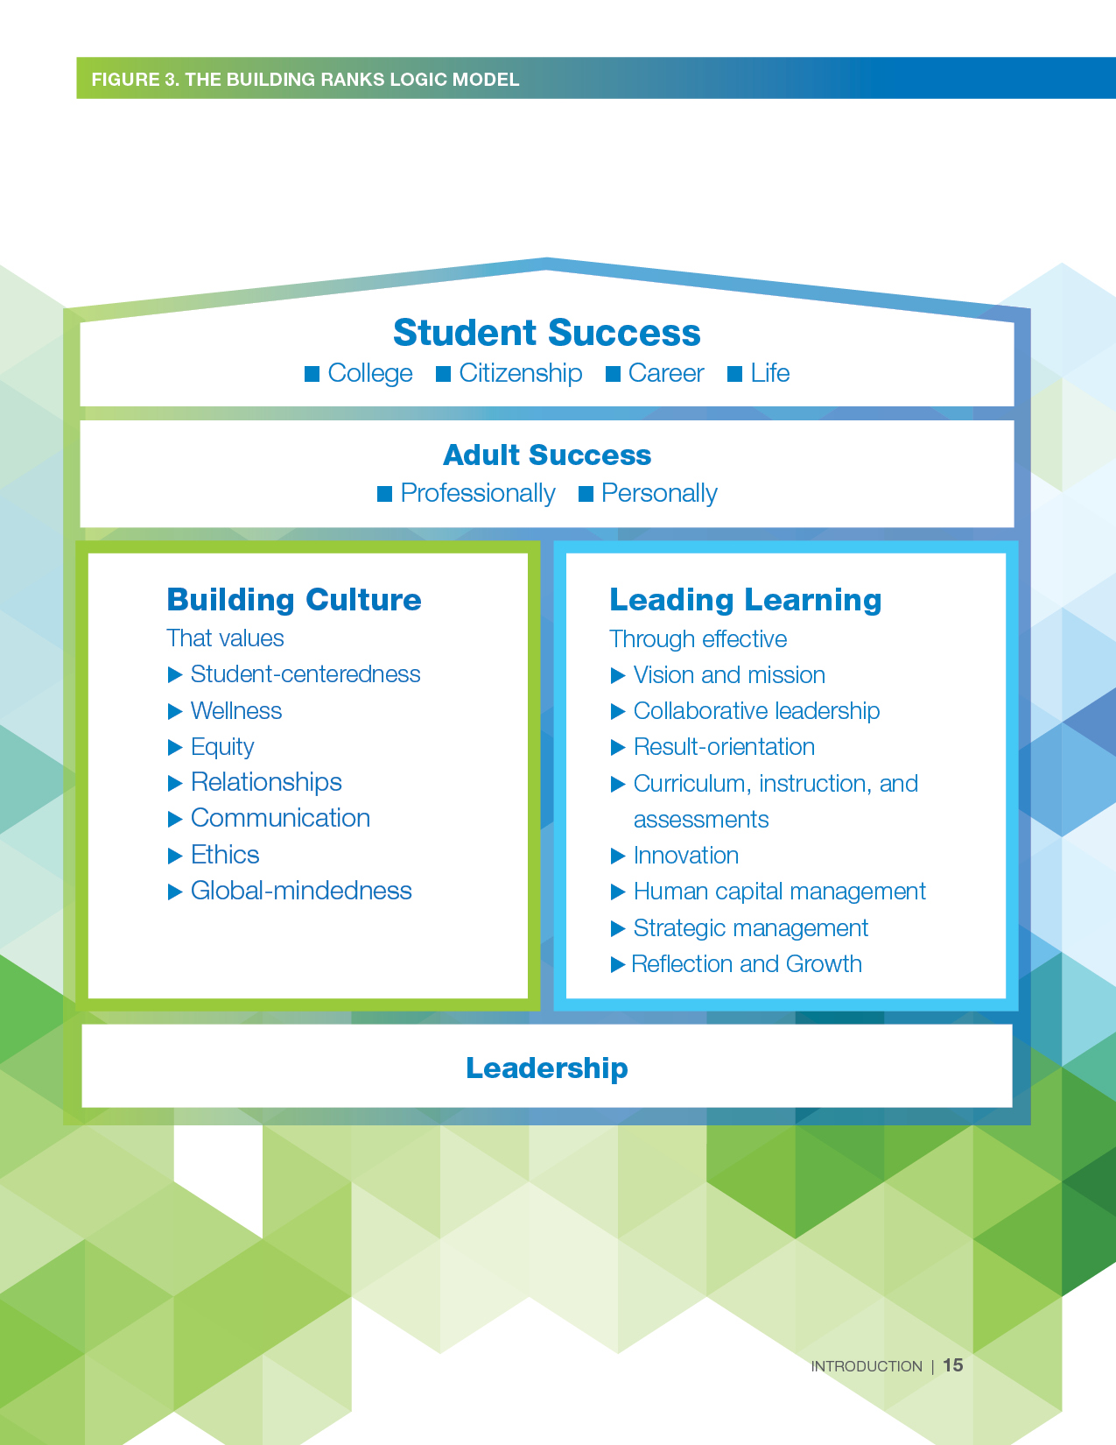
grounded in Building ranks’ equity
Notes:
NASSP developed Building Ranks to create a common language that describes the critical and complex role of the school leader. This session highlights equity – one dimension of the Building Ranks framework. And specifically, one aspect of equity, social justice. NASSP is committed to social justice and supporting your leadership. Thank you for committing to your own social justice leadership.

Slide 4

Enduring Understanding:
Social justice is a cornerstone of our school community.

Slide 5

  Enduring Understanding:
  Everyone deserves equal economic, political, social, & educational rights and opportunities.
  Essential Questions:
  1. How do awareness, knowledge, and understanding of my own identity and history affect my commitment to equity and social justice?
  2. How do awareness, knowledge, and understanding of the identity and experiences of my students, faculty, and staff affect my commitment to equity and social justice?
  3. How can school leaders establish environments that are conscious of culture to ensure implementation of equity and social justice?
Notes:
The essential question and enduring understanding for equity professional development

Slide 6
Ground Rules
Be willing to surface and explore unconscious beliefs and values.
Listen to hear, not respond.
Be willing to think about situations with a new or expanded perspective.
Be mindful that your truth can be different for others.
Honor confidentiality.
Take responsibility for your own learning.

Slide 7
Social Justice Defined
The view that everyone deserves equal economic, political and social rights and opportunities.
(The San Diego Foundation)

Slide 8
  Activity
  In your groups, discuss what the challenges are at your school from a social justice perspective that led you to sign up for this session.
  Possible examples:
  racism, homophobia, pandemic related equity, anti-Semitism, bullying, digital divide, parents or staff not committed to the work, second-guessing your own commitment to social justice & equity, fatigue
Notes:
The essential question and enduring understanding for equity professional development

Slide 9
The world we have created is a
product of our thinking.
We cannot change things until
we change our thinking.
- Einstein
The less we know about each other,
the more we make up.
-Donna Ford

Slide 11
DEI isn’t a box to check
What is DEI really?
Diversity is about the state of being different in multiple ways from gender and race to religion and ideology.
Equity deals with ensuring that students are able to learn equally and that faculty have access to the same resources.
- ex. Increased academic support for students in need
- ex. Differentiation of instruction to allow students who receive information through different means to have that access
- ex. Ensuring every child at home virtually has a laptop and internet access
Equity & equality are not the same thing
Equity helps lead toward equality
*night school
Inclusion is about power as it relates to decisions made and opportunities granted

Slide 12
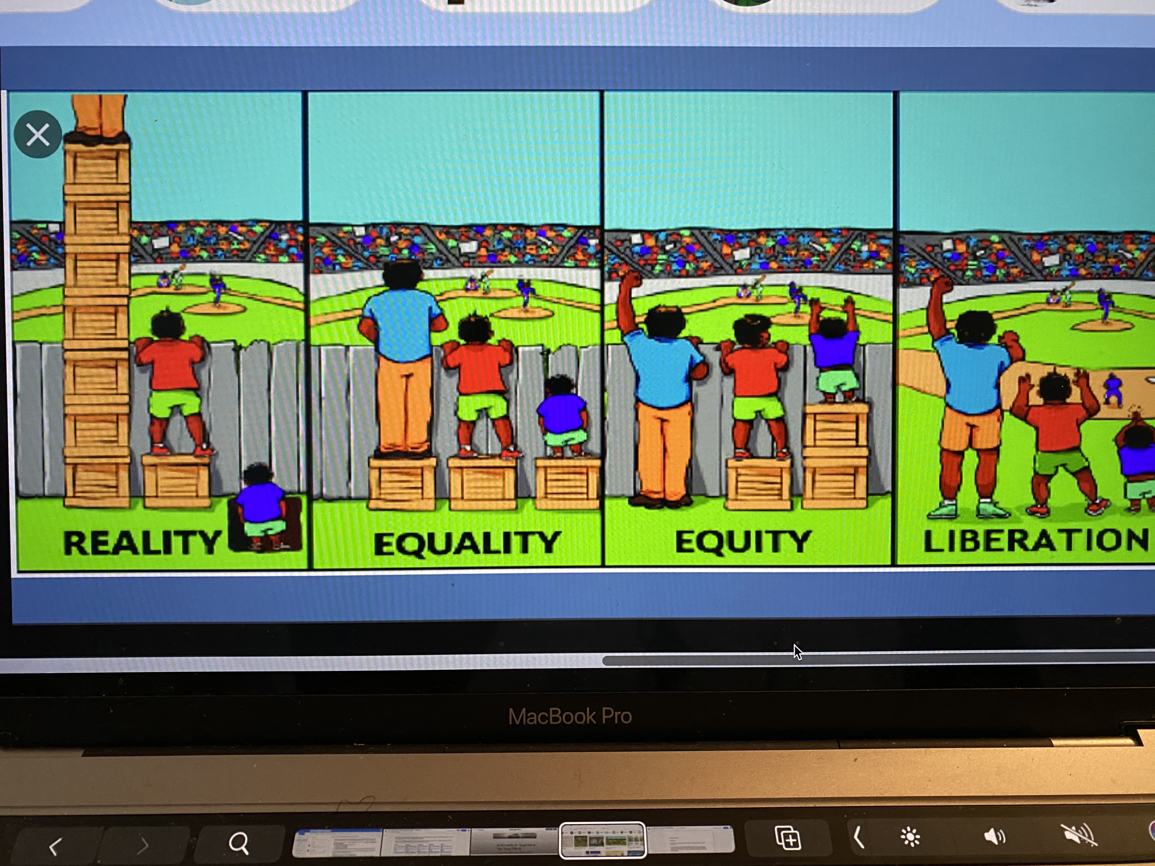

Slide 13
Who Am I?

Slide 14
Activity
Complete the sentence, “I am……” using as many descriptors as you can think of in sixty seconds.
I am _________________________________________.
_____________________________________________.
_____________________________________________.
_____________________________________________.
_____________________________________________.
_____________________________________________.
_____________________________________________.
_____________________________________________.
_____________________________________________.
_____________________________________________.
_____________________________________________.
_____________________________________________.
_____________________________________________.
_____________________________________________.
_____________________________________________.
_____________________________________________.

Slide 15
Men and women are not only themselves; they are also the region in which they were born, the city apartment or farm in which they learned to walk, the games they played as children, the old wives tales they overheard, the food they ate, the schools they attended, the sports they followed, the poems they read, and the God they believe in.
Somerset Maugham

Slide 16
“Not learning tends to take place when someone has to deal with unavoidable challenges to her or his personal and family loyalties, integrity, and identity. In such situations there are forced choices and no apparent middle ground. To agree to learn from a stranger who does not respect your integrity causes a major loss of self. The only alternative is to not-learn and reject the stranger’s world.”
Herb Kohl
I Won’t Learn From You! The Role of Assent in Education

Slide 17
“When I do not know myself, I cannot
know who my students are. I will see
them through a glass darkly in the
shadows of my unexamined life –
And when I cannot see them clearly,
I cannot teach them well”
-Parker Palmer,
Educator

Slide 18
“I truly believe that everyone’s education is
qualitatively improved when we are confronted
with an analysis of our society, when we are asked in an academic setting to struggle with viewing ourselves from another’s perspective and seeing the relationships between our thoughts and ideology that repress/oppress others. We need to be jolted into seeing how our attitudes fit into a systemic application of power within our society.”
- John Fiske’s Power Works, Power Plays

Slide 19
The world we have created is a
product of our thinking.
We cannot change things until
we change our thinking.
- Einstein
The less we know about each other,
the more we make up.
-Donna Ford

Slide 20
Challenges facing students today
Increase in hate crimes
Social media
Mental health/Depression/Suicide
Academic rigors
Bullying
All the -isms
Parental issues?
Increasingly globalized world
Media issues
Historical knowledge/guidance
Identity
School shootings
Body image
Technology
Critical thinking
Career pressures
Busy parents

Slide 21

Reflection on Race
Think of your first memory when race made a difference in your life positively or negatively.
Describe the memory.
What emotions are attached with the memory?
Did you talk to anyone about the encounter?

Slide 22
Reflection on Gender
Think of your first memory when gender made a difference in your life positively or negatively.
Describe the memory.
What emotions are attached with the memory?
Did you talk to anyone about the encounter?

Slide 23


Stages of Racialized and Ethnic Identity Development: People of Color (William Cross)
Pre-Encounter: Limited consciousness of self as “other.”
Encounter: Impact of (usually negative) categorization is felt.
Immersion/ Emersion: Begins the search for positive identity concept.
Internalization: Possesses a positive sense of identity.
Internalization-Commitment: Ongoing actions express a concern for one’s group.

Slide 24
Stages of Racialized and Ethnic Identity Development: White Identity (Janet Helms)
[Pre-Contact &] Contact: Normal”: no particular culture or ethnicity. Sees self as a person of goodwill, unprejudiced, colorblind.
Disintegration: Becomes aware of racism’s impact on one’s own and other’s lives.
Reintegration: Feelings of tension and guilt may be denied by blaming the victim and reasserting the cultural myths of rugged individualism .
Pseudo-independent: Understands cognitively the problem of White privilege, but unsure of what to do about it.
Immersion/ Emersion: begins search for ethnic & cultural background(s) and identifies with Whites who historically allied themselves with people of color in combating racism.
Autonomy: Has developed a positive identity based in reality (vs. a culturally based presumed superiority).

Slide 25

“…our actions are not likely to lead to transcendent change and may indeed, despite our best efforts, be of more help to the system we despise than to the victims of that system whom we are trying to help.”
-Derrick Bell
Notes:
Research has shown that “patterns” of behaviors/characteristics can become more dominant in one culture over another. Have you witnessed any of the behaviors identified in Cultural Styles – Intent/Impact chart? Let’s see how in all these examples, you, as the mainstream teacher may interpret them.

Slide 26
Assignments for Next Session
Part 1
Reflect on your stage of identity development and assess whether you can also be part of the opposite group. For example, think of the following questions:
What was I taught about my identity growing up from my family that most affected my growth positively or negatively?
What messages did I receive about who I was when I left my home every day (in school, from friends, my teachers, etc.)?
How did my schooling reinforce a positive or negative identity development for me?
What experiences in my life influenced the social justice causes I believe in?
What was I taught about the identity of others and how did that affect my identity development?
Did my upbringing create stereotypes and biases towards others that I’ve had to work to change (or still need to)? Please elaborate on your answer.
What about my past identity experiences led me to become an educator and eventually a teacher or school leader?

Slide 27
          Part 2
          Informally begin to assess where occupants of your school are in their stage of identity development.
          This is going to aid you to better engage them in the work that you will be embarking on (or continuing).

Slide 28
Hearing this information makes me think…
What are the implications for me as a leader?
Reflections on my role as a teacher or leader
Challenges I face with respect to social justice & equity in schools are…
Therefore, I will…
By participating in this session, I’ve changed my thinking about…

Slide 29
Leading Social Justice in Your School
Session 1: Who Am I and Why Am I Here?
Designed and Lead by
Dr. Omekongo Dibinga

